Slide 1
데이터분석팀 SEO 작업 가이드
최종 수정일 : 2023-01-30
연구소 데이터분석팀 엄태영PM

Slide 2

C
ONTENTS
작업 가능 범위
작업 내용 상세
유지보수

Slide 3
1
1
작업 가능 범위
PUT TEXT HERE
PUT TEXT HERE
PUT TEXT HERE
PUT TEXT HERE
PUT TEXT HERE
Put text here.
Your text goes here.
Put text here.
Text here
Put text here.
Your text goes here.
Put text here.
Text here
Put text here.
Your text goes here.
Put text here.
Text here
Put text here.
Your text goes here.
Put text here.
Text here
Put text here.
Your text goes here.
Put text here.
Text here
2003
2004
2005
2006
2007
2008
2009
2010
2011
PUT TEXT HERE
PUT TEXT HERE
PUT TEXT HERE
PUT TEXT HERE
Put text here.
Your text goes here.
Put text here.
Text here
Put text here.
Your text goes here.
Put text here.
Text here
Put text here.
Your text goes here.
Put text here.
Text here
Put text here.
Your text goes here.
Put text here.
Text here
Your logo

Slide 4
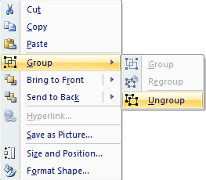
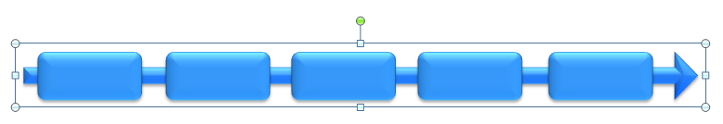
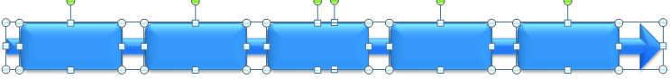
1
2
작업 내용 상세
2
1
3
Right click the object.
Choose Group and then Ungroup.
Click beside the object and drag the arrow over it.

Slide 5
1
3
유지보수
PUT TEXT HERE
PUT TEXT HERE
PUT TEXT HERE
Put text here.
Your text goes here.
Put text here.
Text here
Put text here.
Your text goes here.
Put text here.
Text here
Put text here.
Your text goes here.
Put text here.
Text here
2007
2008
2009
2010
2011
PUT TEXT HERE
PUT TEXT HERE
PUT TEXT HERE
Put text here.
Your text goes here.
Put text here.
Text here
Put text here.
Your text goes here.
Put text here.
Text here
Put text here.
Your text goes here.
Put text here.
Text here
Your logo

Slide 6
TIMELINE DISPLAY– Style 6
PUT TEXT HERE
PUT TEXT HERE
PUT TEXT HERE
Put text here.
Your text goes here.
Put text here.
Text here
Put text here.
Your text goes here.
Put text here.
Text here
Put text here.
Your text goes here.
Put text here.
Text here
2006
2007
2008
2009
2010
2011
PUT TEXT HERE
PUT TEXT HERE
PUT TEXT HERE
Put text here.
Your text goes here.
Put text here.
Text here
Put text here.
Your text goes here.
Put text here.
Text here
Put text here.
Your text goes here.
Put text here.
Text here
Your logo

Slide 7
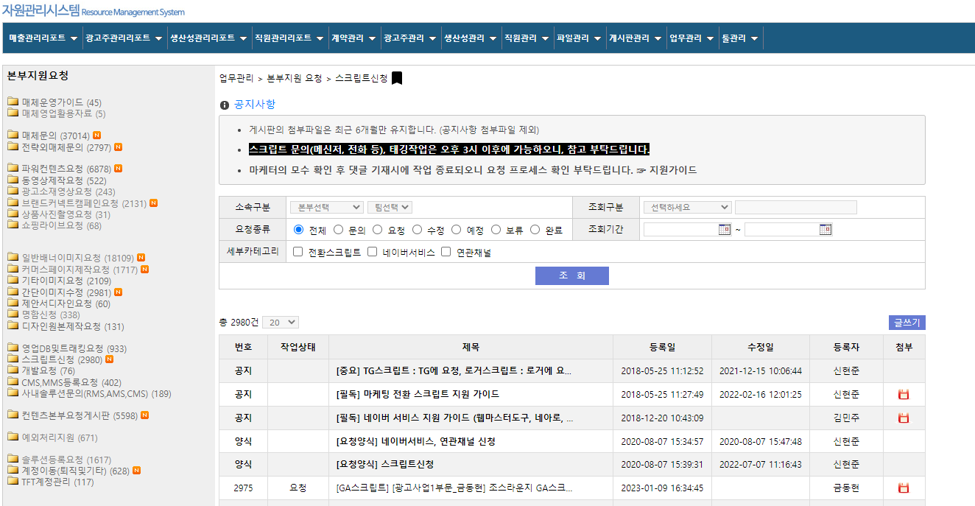
-> 요청자
2
GA 설치 요청 프로세스
-> 데이터분석팀
1
2
3
4
5
RMS > 본부지원요청 > 스크립트 신청 게시판
설치요청 게시글 작성
게시글 필수 항목 작성
권한부여 필수 진행
부여완료 시 댓글작성
10
9
8
7
6
테스트 후 완료
설정 및 설치 진행
GA/GTM 권한 확인
검토 후 특이사항 전달
데이터 분석팀 내부검토
1
RMS 접속 > 업무관리 > 본부지원 요청 >
스크립트신청 > 글쓰기
1
2

